Slide 1
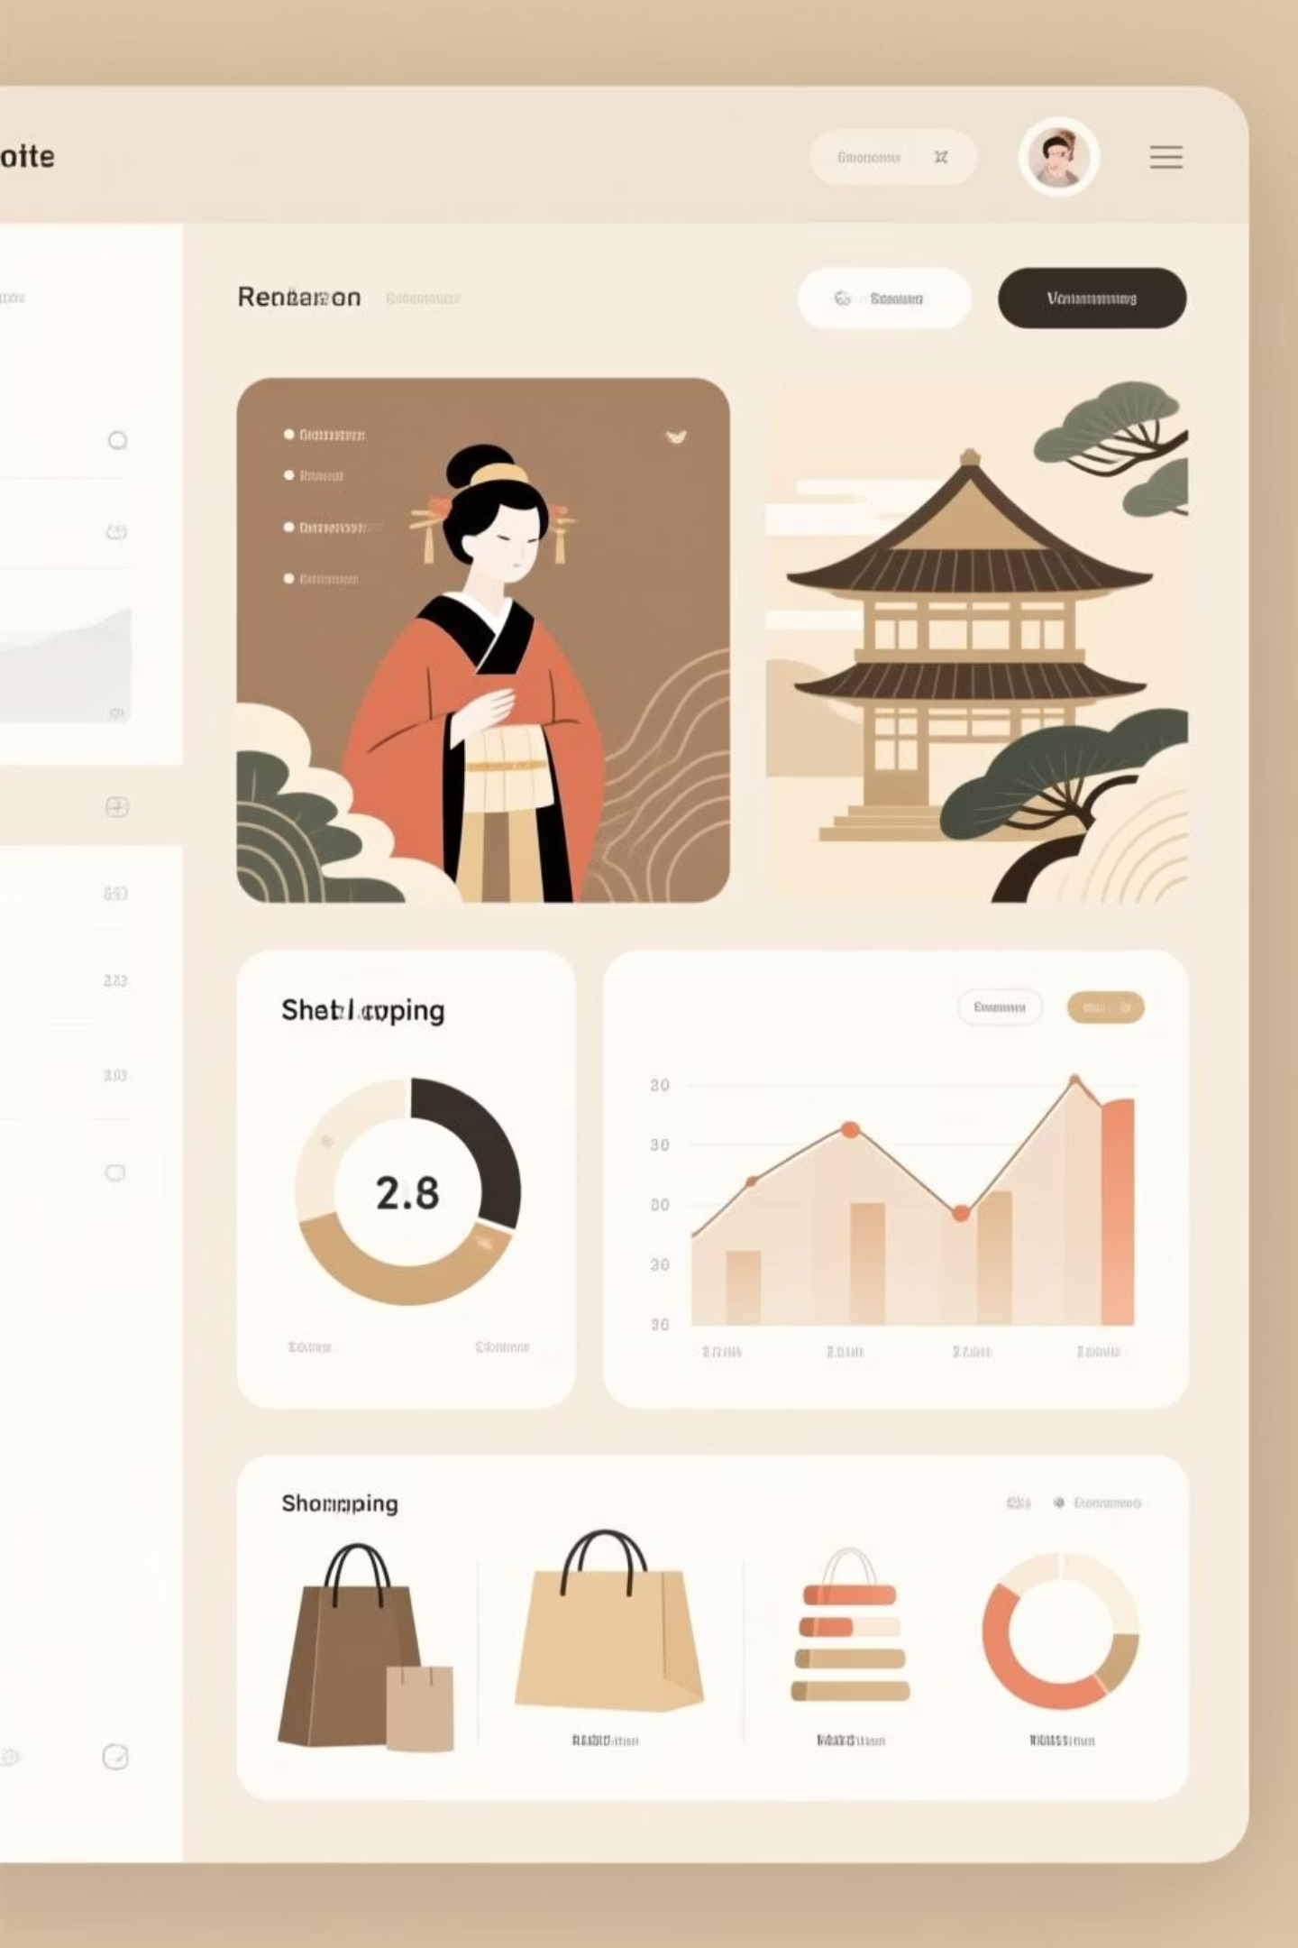
Customer Shopping Behavior Analysis
Uncovering trends in customer demographics, purchase preferences, loyalty patterns, and seasonal behavior through Python, SQL, and Power BI analysis of 3,900 transactions.

Slide 2
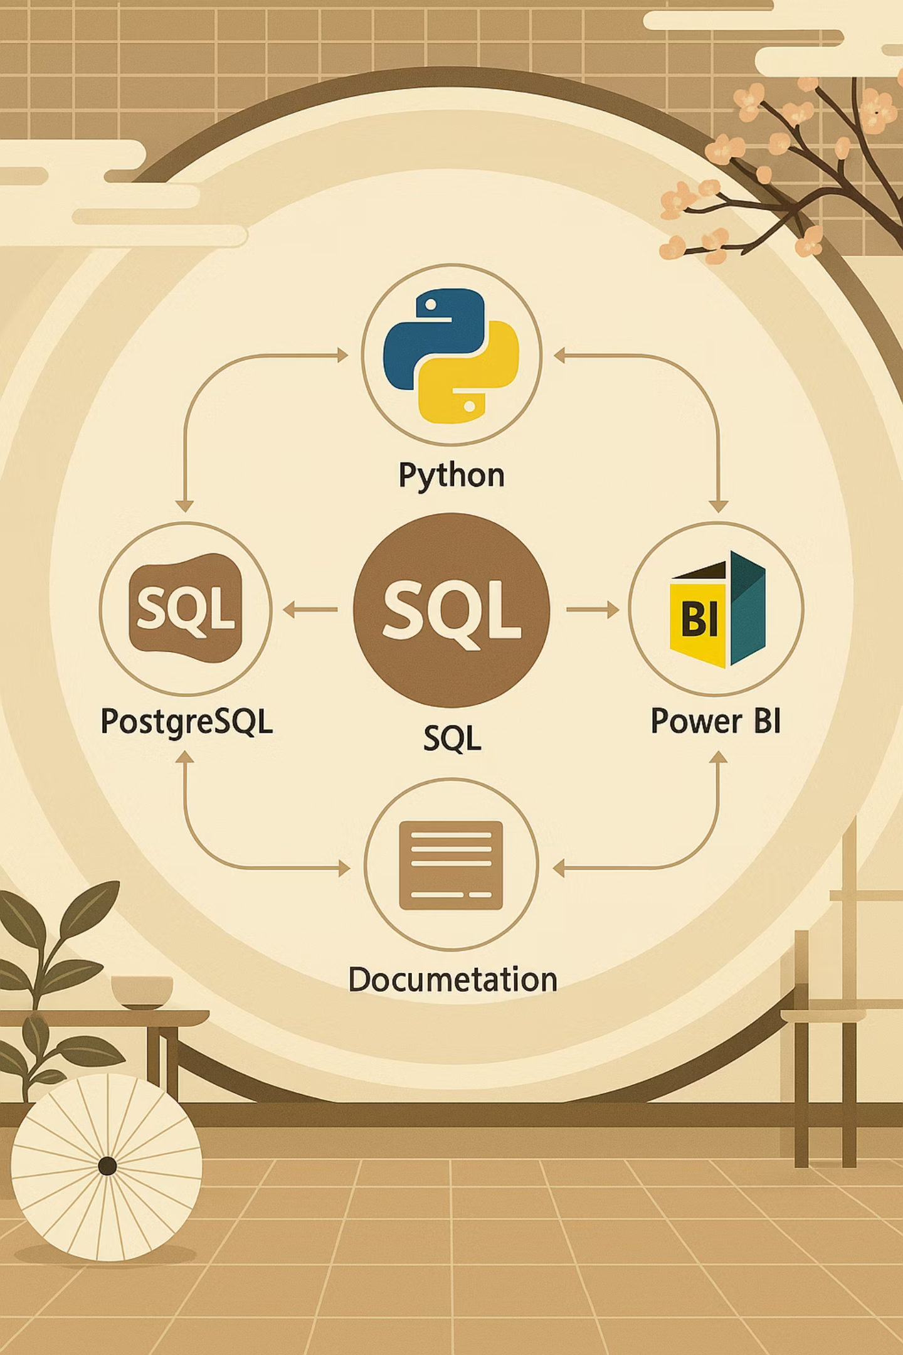
Dataset & Methodology
Dataset Overview
Analysis Approach
3,900 customer transactions analyzed across 18 fields including demographics, purchase behavior, and satisfaction metrics.
Multi-tool analysis combining statistical profiling, database queries, and interactive visualization.
Customer demographics (age, gender)
Python for exploratory data analysis
Purchase details (category, amount, reviews)
PostgreSQL for deep behavioral insights
Loyalty indicators (subscription, previous purchases)
Power BI for interactive dashboards
Shipping and discount data

Slide 3

Revenue Drivers by Demographics
$157,890
$62,143
$60
Male Customers
Young Adults
Average Purchase
Generate significantly more total revenue than female customers, despite similar average purchase values
Age group 18-31 leads revenue contribution, though overall revenue is relatively balanced across all age segments
Consistent spending across demographics with $23.69 standard deviation
Male customers and Young Adults (18-31) represent key segments, with male customers driving higher overall revenue and young adults leading among age groups, indicating potential for focused marketing campaigns and personalized product recommendations.

Slide 4
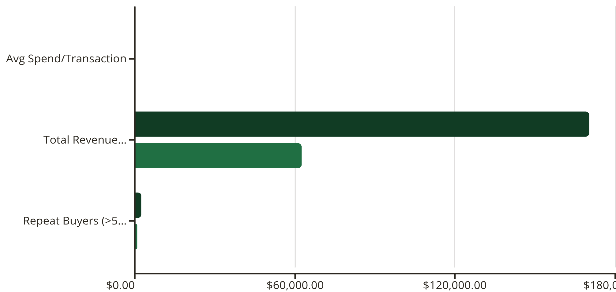
The Subscription Paradox
Key Insights
Non-subscribers demonstrate surprising strength:
Similar average spend per transaction
Nearly 3x greater total revenue contribution
Majority of repeat buyers (>5 purchases)
Despite similar average spending, non-subscribers contribute nearly three times the total revenue and represent the majority of repeat buyers. This indicates that the current subscription program needs significant enhancement to drive comparable value and engagement from its members.
Non-Subscribers
Subscribers

Slide 5






Customer Loyalty Segmentation
Loyal
3,116 customers
Returning
701 customers
New
83 customers
The customer base is dominated by loyal and returning shoppers, with a significant number of repeat customers and a stable mid-tier segment. The very low number of new customers entering the funnel indicates a mature customer base with limited new acquisition, suggesting a need to focus on retention and increasing lifetime value from existing segments rather than aggressive new customer growth.

Slide 6
Product Performance Insights
Repeat Purchase Champions
Top-Rated Products
Discount-Dependent Items
Blouse, Jewelry, Dress, Shirt, and Pants drive the most repeat customers (150+ repeat orders each). These anchor products should lead advertising campaigns.
Gloves (3.86), Sandals (3.84), Boots (3.81), Hat (3.81), and T-shirt (3.78) receive the highest average review ratings. Feature these satisfaction leaders prominently on the homepage.
Hat, Sneakers, Coat, Sweater, and Pants show ~47-50% discount reliance. Consider strategic re-pricing to improve margins on these products.

Slide 7





Discount Strategy Analysis
42.08%
43.79%
Clothing
Accessories
Average discount rate
Average discount rate
43.24%
44.44%
Footwear
Outerwear
Average discount rate
Average discount rate
Critical Finding: All categories exhibit high discount dependency (42-44%), suggesting price sensitivity across the board rather than just margin erosion. Consider shifting to targeted discounts for new or dormant customers only.

Slide 8
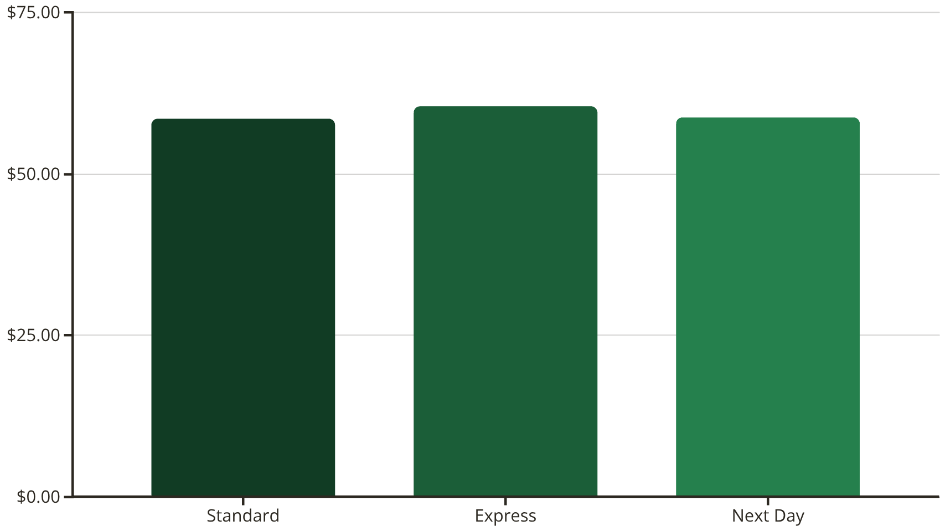
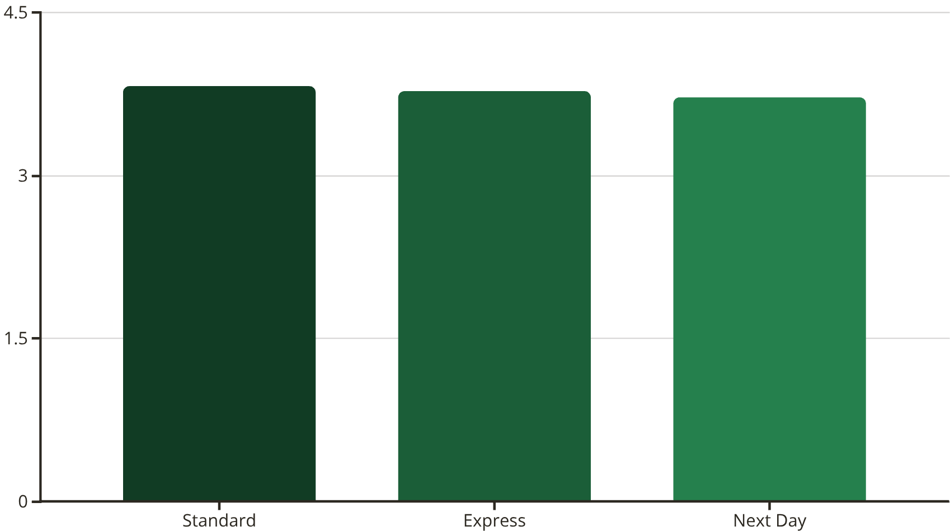
Shipping & Satisfaction
Purchase Amounts by Shipping Type
Customer Satisfaction Ratings
Express customers spend slightly more on average than Standard customers, but neither significantly drives higher spending overall. Next Day shipping now shows similar average purchase amounts to Standard.
Standard shipping achieves the highest satisfaction rating. Additionally, Express shipping now achieves a better customer experience score than Next Day.
Offer Express shipping selectively as an upsell on high-value carts rather than promoting it broadly, since Standard delivers the best satisfaction at a lower cost compared to Express, making it the top performer overall for customer satisfaction. Next Day shipping provides the lowest satisfaction rating.

Slide 9
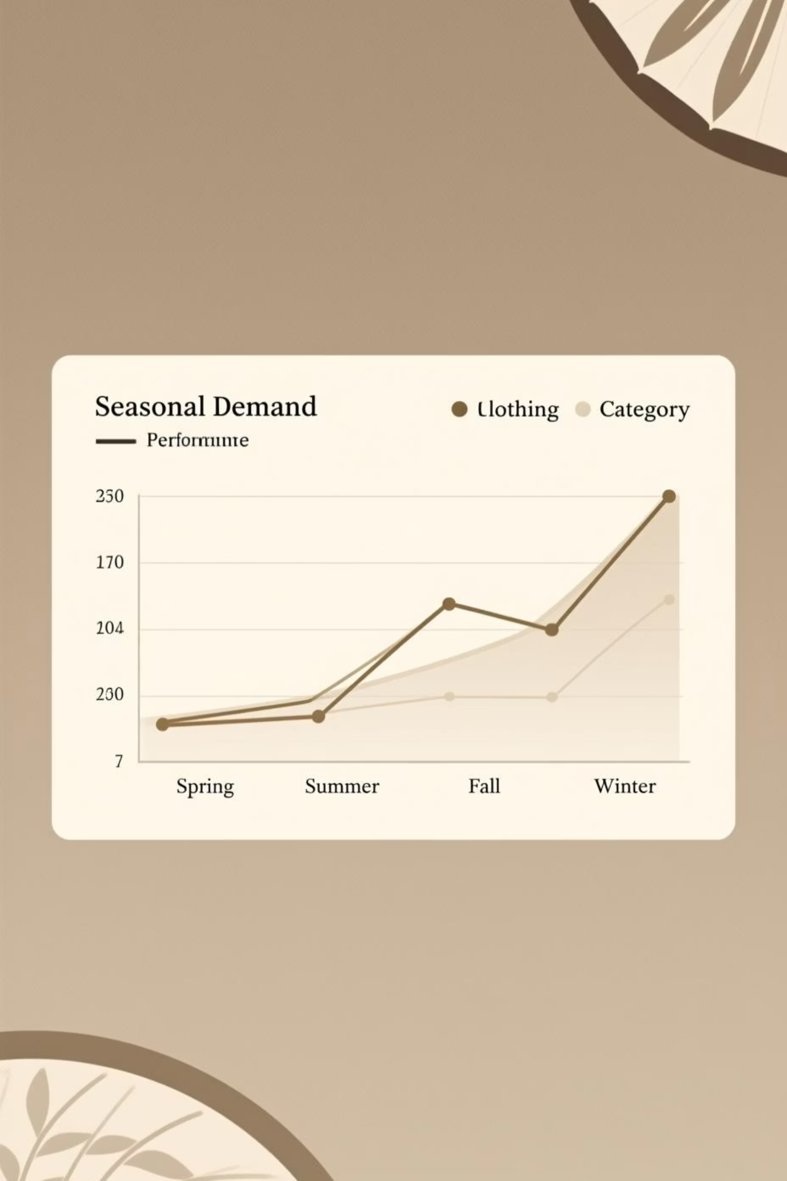
Seasonal Demand Patterns
1
Spring Peak
Clothing category shows strong performance with seasonal refresh demand
2
Summer Stability
Consistent revenue across categories maintains baseline performance
3
Fall Transition
Moderate activity as customers prepare for winter wardrobe
4
Winter Peak
Clothing revenue surges with cold-weather and holiday shopping
Business exhibits stable year-round performance with moderate seasonal variation. Prepare targeted campaigns for Spring and Winter peaks while maintaining consistent inventory throughout the year.

Slide 10






Strategic Recommendations
High-Value Segments
Revamp Subscriptions
Prioritize campaigns targeting Male and Young Adult customers through tailored product recommendations and demographic-specific email marketing.
Add exclusive offers, loyalty points multipliers, early access to collections, and personalized incentives for Loyal customers (3,800+ users).
Optimize Discounts
Promote Anchors
Reduce blanket 42-44% discounts. Use targeted promotions for new/dormant customers only. Re-price high-discount-reliance products.
Feature repeat-driving products (Blouse, Jewelry, Dress) in advertising. Bundle high-performers to increase average order value.
Smart Shipping
Seasonal Strategy
Keep Standard as default (highest satisfaction). Offer Express selectively as upsell on high-value carts to optimize logistics costs.
Launch targeted Spring and Winter campaigns for Clothing peaks while maintaining steady year-round inventory for stable baseline demand.

